Slide 1
Advanced Algebra Applications
Student Created Art
Mr. Waddell
2008-09

Slide 2
Four requirements for this art:
1. Use the Golden Ratio in your art
2. Use the Fibonacci Numbers through F7
3. Have a well developed theme
4. Have Artistic Merit (color, design, etc)
5. Include a write-up explaining your use
What is NOT required: specific media or specific colors.

Slide 3
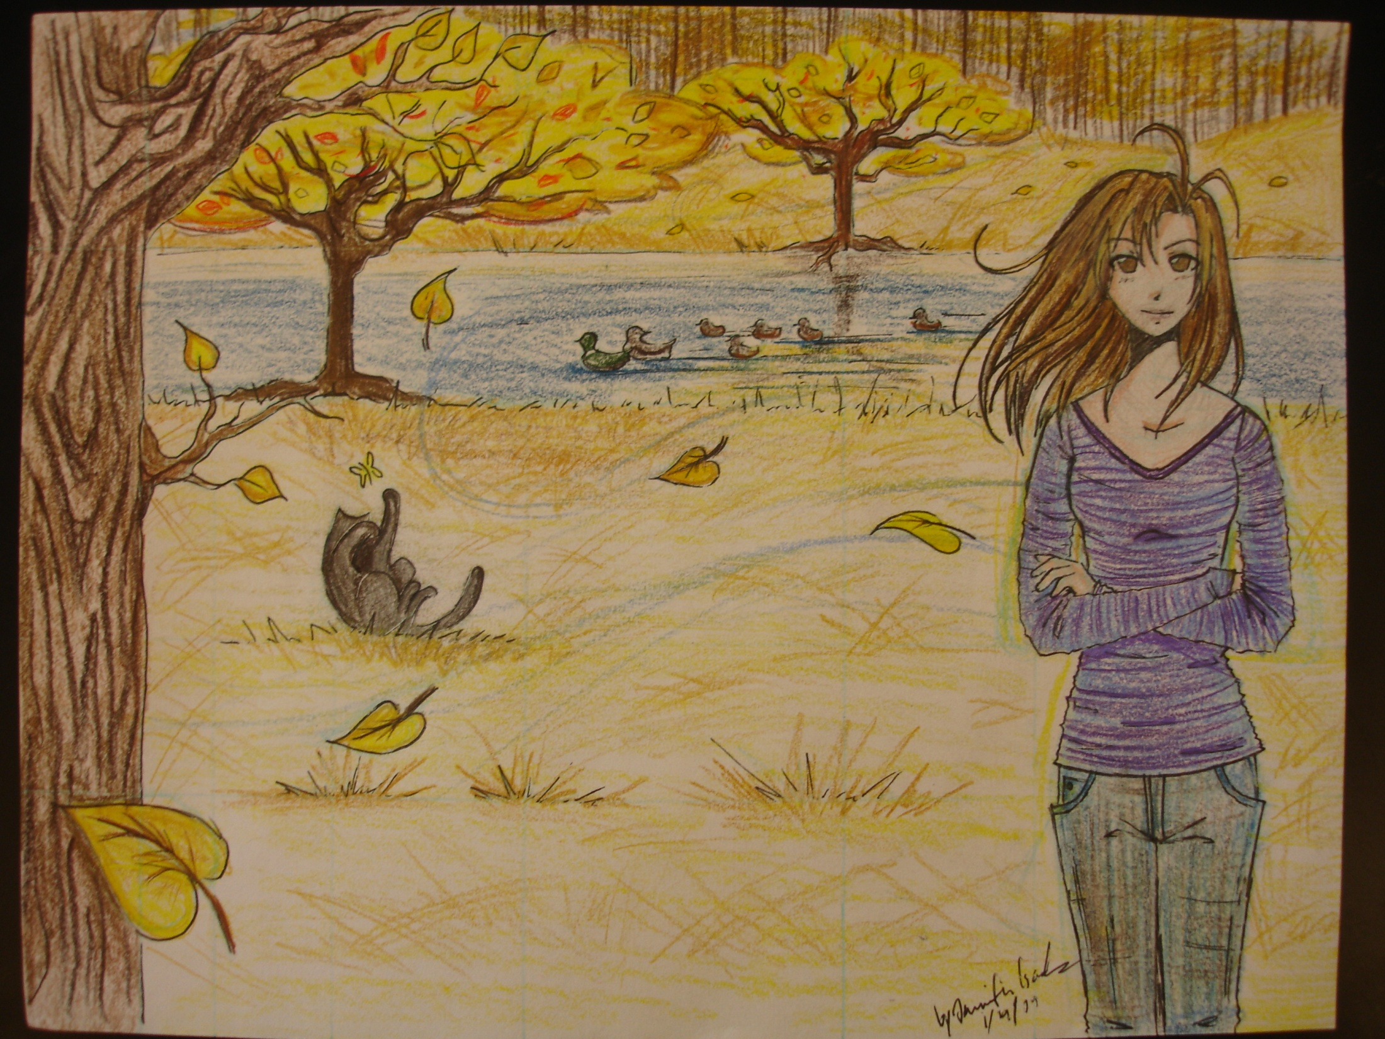

Slide 5
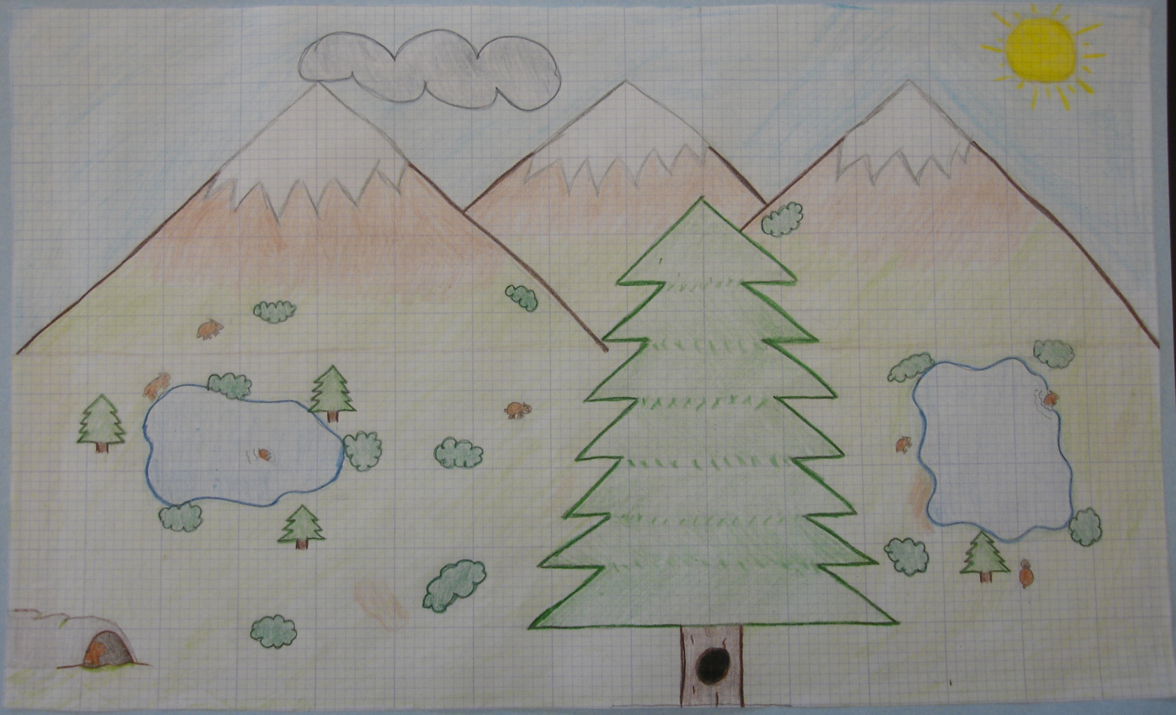

Slide 6
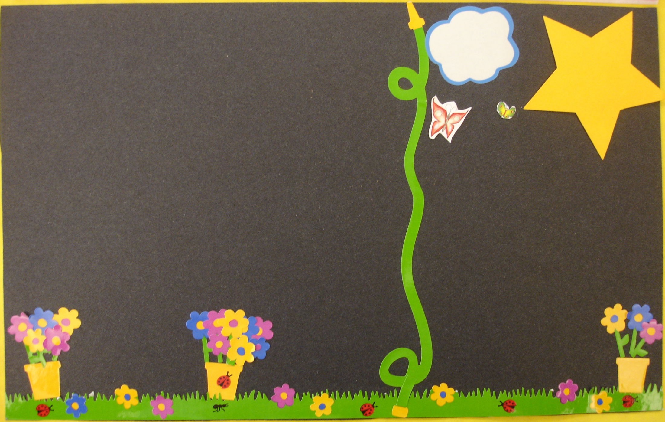

Slide 7
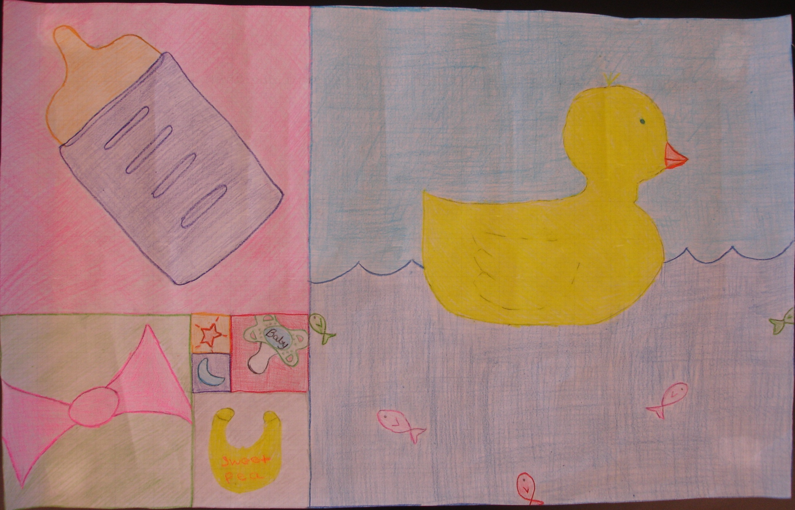

Slide 8
